Slide 1
Accessing NeSI HPC Resources

Slide 2






Who is NeSI?
New Zealand eScience Infrastructure
Provides HPC service to enable NZ’s researchers to tackle the world’s largest problems
Investors

Slide 3

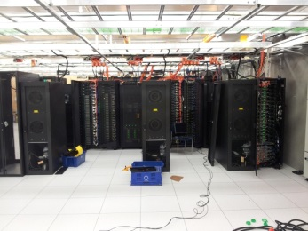

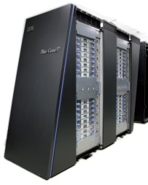
Who is NeSI?
HPC systems
UoA+ Landcare + Otago
6,000 Intel CPU
40TB memory, 100TFlops
200TB storage, 40GBit/s IB network
NIWA
3488 IBM POWER6 CPU
8.7TB memory, 65.57TFlops
200TB storage, 40GBit/s IB network
UC
8612 IBM POWER CPU
9.6TB memory, 71.4TFlops
172TB storage, 3D Torus interconnect+ IB

Slide 4

Why do I need High Performance Computing (HPC)?
Size Problem
The problem is too big and it doesn’t fit in my laptop/desktop
Often memory issue : Usually 16GB vs TB

Slide 5

Why do I need HPC?
Large Data Sets
The input and/or output data is too big and very slow. Usually
100 GB vs 100 TB (=100,000 GB) to 1PB(=1,000,000 GB)
Image courtesy of FreeDigitalPhotos.net

Slide 6

Why do I need HPC?
It takes a lot of time
My simulation requires a lot of time to be completed and it also
will compete with web browser, email client, etc.

Slide 7

Why do I need HPC?
Time constrains
I want the results now, not in three years!
I need to process large amount of data in a short period of time.

Slide 8
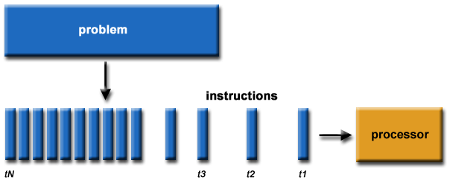
Why do I need HPC?
Parametric Jobs
I need to run the same code several times using different
parameters or input files.

Slide 9
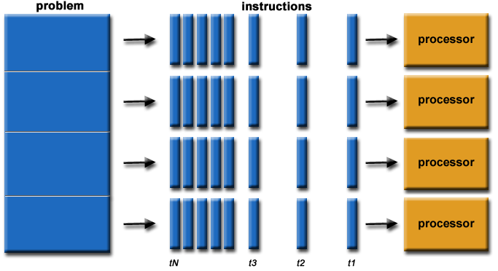
Why do I need HPC?
Parametric Jobs
I need to run the same code several times using different
parameters or input files.

Slide 10

Why do I need HPC?
Get expert help
I know to use the application but I don’t have time for :
develop Linux sysadmin skills.
learn how to install it.
optimize the application.
optimize the work-flow.
Image courtesy of FreeDigitalPhotos.net

Slide 11
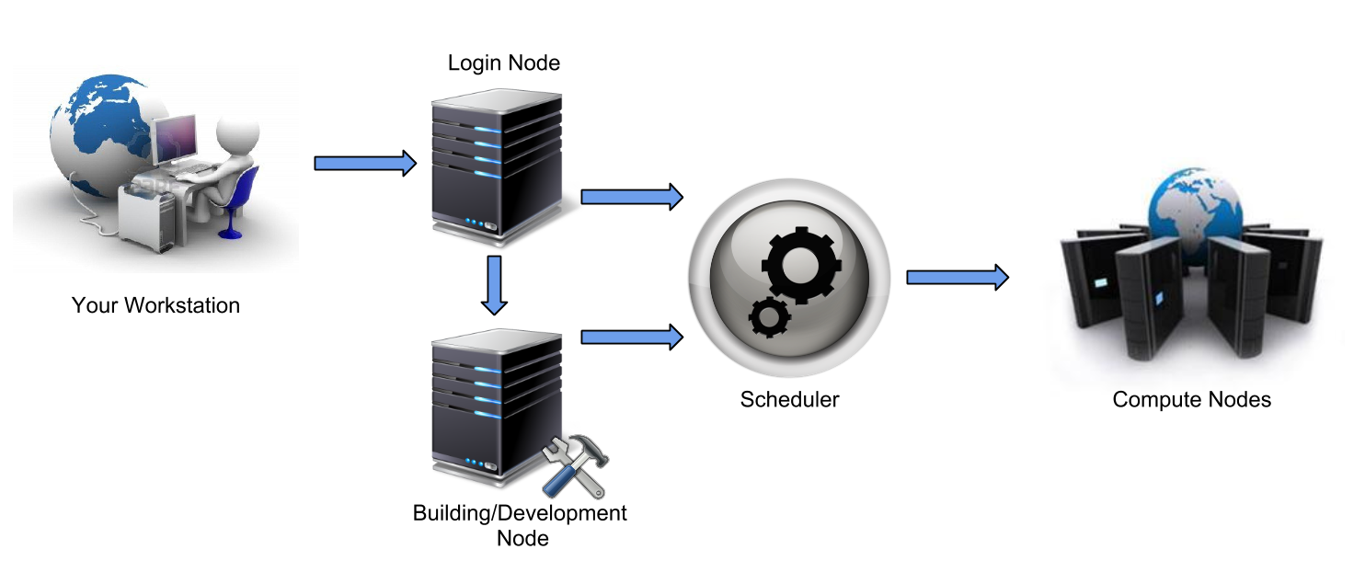
General Overview
Using the cluster

Slide 12

Using the cluster
Overview
The cluster is a shared resource and work must be scheduled.
Jobs are queued and are executed on the compute nodes.
The login node is not for running jobs, it is only for file management and job submission.

Slide 13
Demo: Using the cluster
Start with the basic,
How to connect to the cluster via SSH
Followed by a topic audience may like (consult the local host)
How to submit an R job
Show how much speed-up you get.

Slide 14
Case Studies
(Optional)
Introduce some success stories of local researcher (if available)

Slide 15

I’d like to have an access!
https://www.nesi.org.nz/apply
High Priority
Low Priority
Notes:
Covered by institution’s investment/subscription : Massey Uni.
Plant&Food: Data Subscription (no compute)

Slide 16
I’d like to have an access!
NeSI Access Policy
Merit | Institution | Proposal Development | PostGrad
Covered by Crown | Covered by institution | Covered by Crown | Covered by Crown
Evidence of academic merit required | Block allocation (core hours + consultancy) | Fast access | Any accredited postgrad. research programme in NZ
Up to 1 year (renewable) | Governance by institution Tech. assessment by NeSI | Small allocation (1000 core h) Time bound (1 month) | Up to 1 year (renewable)
High Priority
Low Priority
Notes:
Covered by institution’s investment/subscription : Massey Uni.
Plant&Food: Data Subscription (no compute)

Slide 17







Computational Science Team
Consultancy and Training to best utilize HPC resources
Enhance the performance of research software codes
Troubleshoot memory and other or I/O bottlenecks
Connect researchers and scientific software experts

Slide 18
Talk to NeSI!
www.nesi.org.nz

